Slide 1
ONLINE TOURISM MARKETING- Introduction
Internet has increasingly become a popular medium for marketing.
Internet is ideal for marketing tourism
Internet is the global 'network of networks“
Interlinked computers operating on a standard protocol
Allows data to be transferred between them.
Important aspect of the Internet is its connectivity, the ability to allow everyone to access the network.
Internet connects
companies with companies, companies with customers, and people with people without regard to time, space

Slide 2
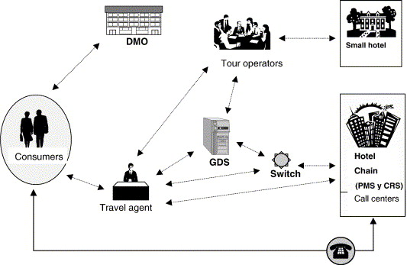

Slide 3
